Slide 1



DEPARTMENT OF INFORMATION TECHNOLOGY
An Autonomous Institution
Approved by AICTE, New Delhi | Affiliated to Anna University, Chennai
MULTI-PATTERN FINGERPRINT SECURITY SYSTEM
PROJECT BY SUPERVISOR
NITHYANANTHAM.R (113021205036) MS. S.MANGALAPRIYA , M.E
ARVINDHAN.G (113021205008) ASSISTANT PROFESSOR

Slide 2
AGENDA
Abstract Objective Literature Survey Existing System Drawbacks of existing system Proposed System Advantages of proposed system Calculations Block diagram Advantages of proposed work | 11. Hardware tool requirements 12. Software tool requirements 13. Modules 14. Model output 15. Sample output 16. Conclusion 17. Future works 18. References

Slide 3
ABSTRACT
This paper proposes a multi-pattern fingerprint security system to enhance security measures. The proposed system integrates an Arduino Uno board, a fingerprint sensor, and a database to provide advanced security features. The system's design allows for multiple fingerprint patterns to be stored in the database, thereby increasing the system's flexibility and versatility.
The proposed system's architecture is based on a client-server model, with the Arduino Uno board acting as the client and the database acting as the server. The fingerprint sensor is used to capture the user's fingerprints and send the data to the Arduino Uno board for processing. The Arduino Uno board then sends the fingerprint data to the database for storage and authentication. The system also includes a graphical user interface (GUI) that allows users to register and manage their fingerprints.

Slide 4
ABSTRACT
The proposed system's main advantage is its ability to store multiple fingerprint patterns, allowing for more secure authentication. The system's design is also cost-effective and can be easily integrated into existing security systems..
In conclusion, the proposed multi-pattern fingerprint security system is an innovative solution that enhances security measures. The system's design, which includes an Arduino Uno board, a fingerprint sensor, and a database, provides advanced security features that can be easily managed through a graphical user interface. This system can be used in various applications that require advanced security measures, including banking, healthcare, and government institutions.
Keywords: Fingerprint, Arduino, SQL, Multi-pattern, Security system

Slide 5
OBJECTIVE
Both pin-based and biometric security systems need advancement in security. protecting one's information by overcoming the disadvantages of both pin-based and biometric security systems.
In all aspects, both pin-based and biometric security system has some unique process or technique that is been followed to protect one's information so the objective of this paper is to correlate both the process or techniques used in a pin-based and biometric security system to overcome both systems disadvantages and make a reliable technique and secure platform.

Slide 6
LITERATURE SURVEY
S.NO | YEAR | TITLE | AUTHOR | ADVANTAGE | DRAWBACK
1 | 2011 | The research of double biometric identification technology based on finger geometry and palmprint | Lang Zhai, Qi Hu. | process of matching will be fast and highly active. | only used palm and fingerprints
2 | 2020 | Finger-Knuckle-Print Recognition Using Deep Convolutional Neural Network | Selma Trabelsi, Djamel Samai, Abdallah Meraoumia, Khaled Bensid, Azeddine Benlamoudi. | use own Convolutional Neural Network (CNN) to identify persons | Consumes more data Less data efficiency

Slide 7
LITERATURE SURVEY
S.NO | YEAR | TITLE | AUTHOR | ADVANTAGE | DRAWBACK
3 | 2020 | Finger vein recognition based on Deep Convolutional Neural Networks. | Lecheng Weng, Xiaoqiang Li, Wenfeng Wang. | optimized neural network is used to automatically evaluate the features of the preprocessed images. | To implement this method, the preprocessed image of finger vein is needed
4 | 2014 | A Novel algorithm for Secure Internet Banking with finger print recognition. | R. Priya, V. Tamilselvi, G.P.Rameshkumar. | Gives a solution through a novel algorithm with finger print recognition (IBC) | More vulnerable as it uses single biometric data

Slide 8
LITERATURE SURVEY
S.NO | YEAR | TITLE | AUTHOR | ADVANTAGE | DRAWBACK
5 | 2019 | Biometric Authentication Using Palm Dorsal Vein Patterns. | Yutthana Pititeeraphab, Chuchart Pintavirooj | radius distance methods to find the position of the concave of the finger from the hand contour | time consuming process

Slide 9
EXISTING SYSTEM
There are many services and providence through fingerprint security systems such as biometric door locks, time and attendance systems, mobile devices, payment systems, and border control which are prolonged sustained in use for specific purposes and in security which is termed to be the existing system, meanwhile which also has a lot of drawbacks namely accuracy, privacy and hygiene concern and limited applications. To resolve all the issues we tended to create the proposed system.

Slide 10
DRAWBACKS FOR EXISTING SYSTEM
lack of combinations and uniqueness
low affirmation of protection or security
security can be easily breached or biased using some known techniques such as brute-force attacks, master prints, etc…

Slide 11
PROPOSED SYSTEM
The proposed system “Multi-pattern fingerprint security system” improvises the method of fingerprint recognition which includes combinations of multiple fingerprints which results in a complex pattern. Thus the system uses an Arduino UNO board to access the data, where the data is collected from the fingerprint scanner from the user of different fingers in series is been and applied or saved onto the data in the database (SQL server), thus the modification of finger data requires verification of the person who is been the user in this case, the following images and code explain the proposed system briefly. Thus this advancement also tends in cost effectiveness, security of one’s data, and accessibility.

Slide 12
ADVANTAGES FOR PROPOSED WORK
Justifies possible protection by including both the causes in the existing method that is uniqueness and combination
Could affirm high-rated protection and security
Not easy to breach one’s data because requires a lot of data to breach itself

Slide 13
CALCULATIONS
Pin-based combinations consist of 4 dials and 10 digits (0 to 9)
n^4
Number of combinations = 10*10*10*10 = 10000
Combinations formula
C(n,r) = n! / (r!*(n-r)!)
Multi-pattern fingerprint system(MPFS)
C(10,4) = 10! / (4!*(10-4)!)
C(10,4) = 210 unique combinations
when r = 1 then C(10,1) = 10! / (1!*(10-1)!) = 10 unique
Combinations

Slide 14
PROPOSED WORK-FLOW BLOCK DIAGRAM
START
LOGIN
SUCCESS
INVALID
REGISTER
ENTER DETAILS
ADD FP
MODIFY
FP CHECK
SAVE DATA
VERIFIED
CHANGES SAVED
NOT VERIFIED
STOP

Slide 15
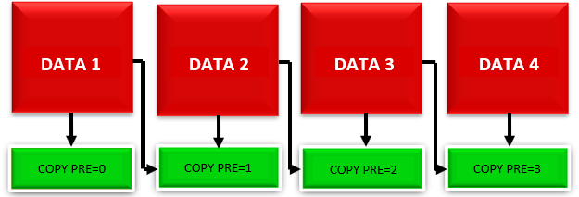
LOGIC USED
EXISTING TECHNIQUE
Use of the convolutional neural network to detect and store single biometric data for a single user
PROPOSED TECHNIQUE
Here, we detect and store multiple biometric data for single user

Slide 16
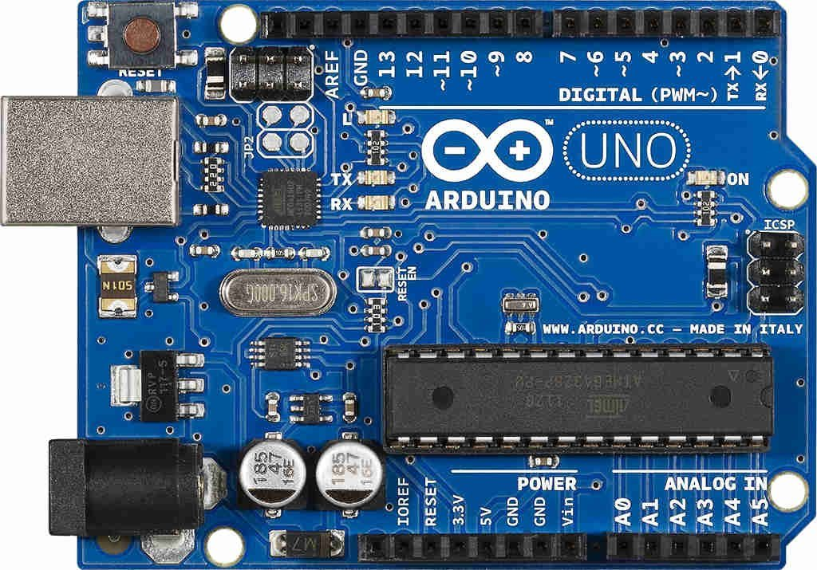
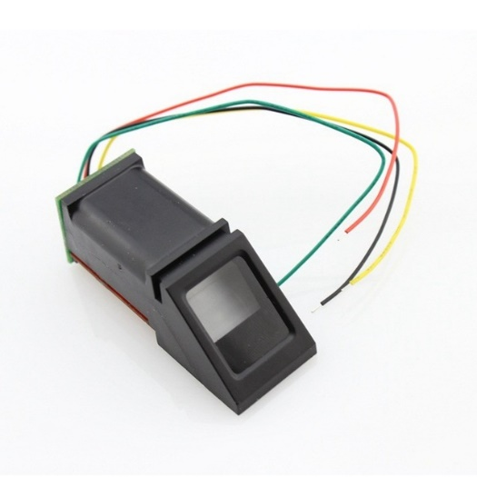
HARDWARE TOOL REQUIREMENTS
Arduino UNO R3
Optical Fingerprint Scanner

Slide 17



SOFTWARE TOOL REQUIREMENTS
Microsoft SQL server management studio
Arduino IDE
Visual studio

Slide 18
MODULES
Login form
Registration catalog
Fingerprint scan form
Fingerprint checking form

Slide 19
MODULE 1 Login form
Here in the login form section, we collect data from the user that is the details from the user such as username and preferred password. By development, we used the path of the SQL server management studio to store the data of the user in the created login database in the server and a connection is been created between the login page and database under the login function which is been coded to collect the data from the user. Without login completion, the user cannot enter the security panel which is the authentication section.

Slide 20
MODULE 2: Registration catalog
From successful login, the user is able to enter the registration catalog, which has three primary sections namely the registration section, database grid view, and the task section where each section has its own priorities and specification. From the registration section, the user has to enter his personal details included on the page.
To newly include data the registration can be completed by adding a combination of a fingerprint with respect to the ID of the user which will be followed, after enrolling the user data will be visible in the database grid view and the data of some specific users can be searched using the search bar.

Slide 21
MODULE 2: Registration catalog
In the task section there will be two buttons one to save, and another to modify where this modify includes the updation of data and deletion of data.
Once the data is been enrolled it has to be saved to be viewed in the grid view if any changes has to do means the modify button helps here, even though to modify the data the system authenticates your fingerprints to make the user to modify such as update or delete his\her data from the database.

Slide 22
MODULE 3: Fingerprint scan form
After completion of registration with a unique ID, now the user will be able to add his fingerprint to the system through the optical fingerprint sensor.
Here in this fingerprint storing form, the ID mentioned in the registration form will be visible in the biometric data pallet, then as said this is the combination and uniqueness of the security system the user will be mentioning his unique number in different aspects below the Redbox available and after entering data onto the textbox the user will be requested to enter his different combination of fingerprints to

Slide 23
MODULE 3: Fingerprint scan form
complete his enrollment by clicking the scan button below the textbox for each different biometric data, after successful entry of fingerprint, the Redbox will turn into green-boxes which resembles a successful entry of fingerprint, and by clicking the submit button the given biometric data of the user will be stored into the database as per the ID given with respect to each byte code saved in the sensor by itself.

Slide 24
MODULE 4: Fingerprint checking form
This form is basically used in the modification section, where if a user needs to modify his data the user will be authenticated with his biometric data with respect to the combinations given by the user himself so then the user will be able to modify the details which will be resembled into the database. The process of checking is also similar to storing method, for each biometric data the scan button has to be clicked to authenticate the user's biometric combination and to be verified for further processes such as updating new data or deleting the existing data.

Slide 25
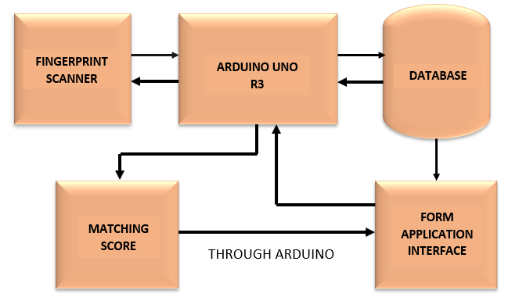
MODEL OUTPUT

Slide 26
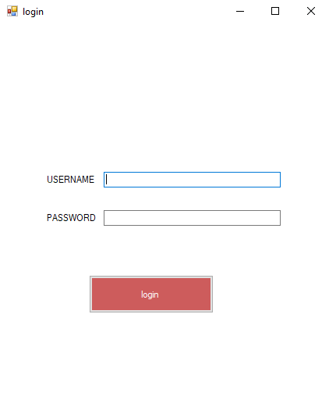
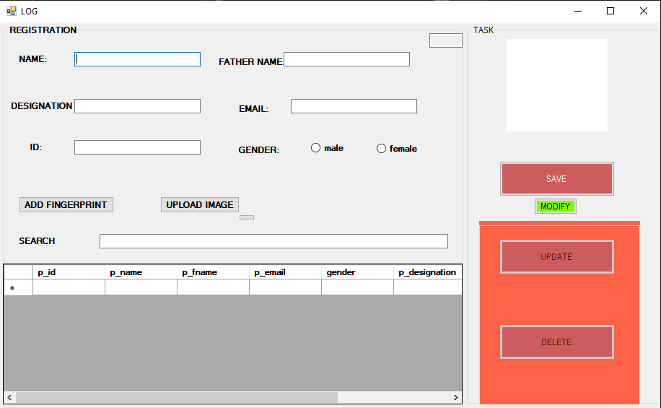
SAMPLE OUTPUT
Login page
Registration page

Slide 27
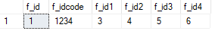


SAMPLE OUTPUT
Fingerdata Database
Login Database
Registration Database

Slide 28
CONCLUSION
In this advanced technological world, the data of one individual can be shared over the network very easily even though with many security systems, but they all have certain limitations of work which can be easily biased which leads to leakage of data. So we collectively gathered information on the protection enhancement of data which we developed the multi-pattern fingerprint security system which has the ability to stand as a firewall for the data that are been store in any kind of database. This is the more enhanced, improvised security system that we deliver for the privacy of one individual.

Slide 29
FUTURE WORK
Enhancing the UI and UX design
Including gestures that make the work of the user easy and convenient.
Optimizing the data collection much faster.
In the purpose of automation and the use of machine learning is to predominantly reduce the time complexity even more.
Surpassing the use of databases by cloud storage because databases might cost large amounts of data.
Increase in use of this security system in various fields such as home security and many more.

Slide 30
FUTURE WORK
Enhancement of fingerprint scanner with high FAR (false acceptance rate).
Development of mobile applications for different use cases.
Integrating the same methodology with other biometric modalities.

Slide 31
REFERENCES
HE, Mingxing, HORNG, Shi-Jinn, FAN, Pingzhi, et al. Performance
evaluation of score level fusion in multimodal biometric systems. Pattern
Recognition, 2010, vol. 43, no 5, p. 1789-1800.
TAO, Qian et VELDHUIS, Raymond. Threshold-optimized decision-
level fusion and its application to biometrics. Pattern Recognition, 2009,
vol. 42, no 5, p. 823-836.

Slide 32
REFERENCES
FAKHAR, Khalid, EL AROUSSI, Mohamed, SAIDI, Mohamed Nabil,
et al. Fuzzy pattern recognition-based approach to biometric score fusion
problem. Fuzzy Sets and Systems, 2016, vol. 305, p. 149-159
JAMDAR, Shradha D. et GOLHAR, Yogesh. Implementation of uni-
modal to multimodal biometric feature level fusion of combining face
iris and ear in a multi-modal biometric system. In: 2017 International
Conference on Trends in Electronics and Informatics (ICEI). IEEE,
2017. p. 625-629.

Slide 33
THANK YOU

